Slide 1
MIDWEST REGIONAL ORCHID SHOW
Show Prep, December 2026
Show December 12 to 13, 2026. Registration deadline November 30. Entering 6 plants. Goal: at least one award nomination.

Slide 2
The six entries
• P-001 Paph rothschildianum 'Columbus Gold', the anchor; stake the second spike by November 28.
• P-014 Paph sukhakulii, watch for spider mite; isolate if needed.
• C-009 Cattleya jongheana, timing tight, expect peak near December 10.
• PH-031 Phalaenopsis schilleriana, groom lower leaves, support the spike.
• C-022 Cattleya walkeriana coerulea, division from Dorothy; first show.
• M-005 Masdevallia veitchiana, keep cool in transit, do not let it cook.

Slide 3
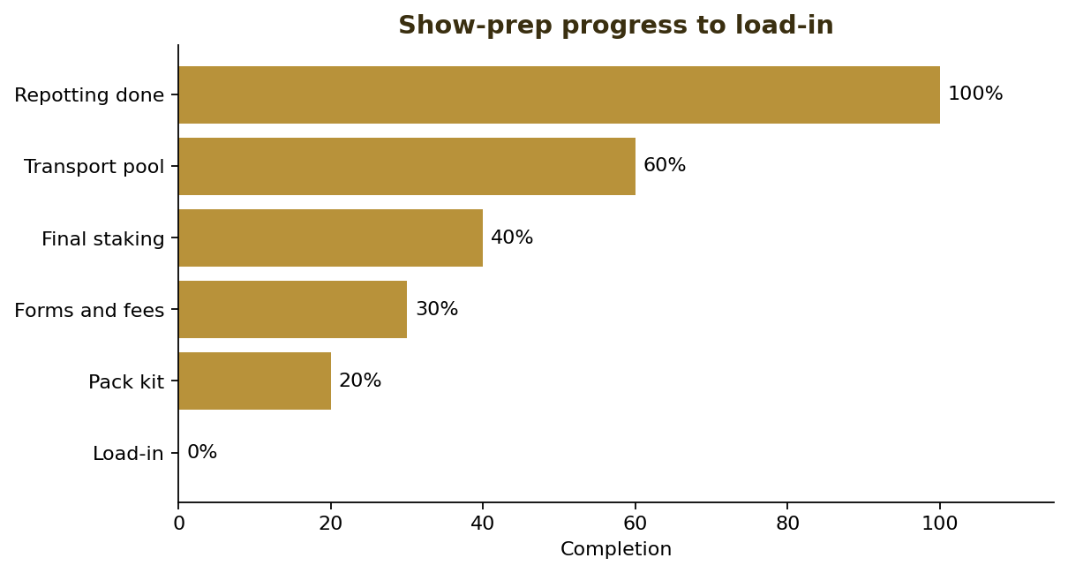
Prep progress
• Repotting weekend done; entries in final media, no late repots.
• Transport pool and judging volunteers being confirmed.
• Final staking, grooming, and photos in the last week.
Completion toward load-in

Slide 4
Timeline
• October 31, 2026: repotting weekend done.
• November 21, 2026: society meeting, confirm transport and volunteers.
• November 28, 2026: final staking, grooming, photograph each entry.
• November 30, 2026: submit forms and fees online before midnight.
• December 11, 2026: pack; December 12 load-in by 8:00 AM.

Slide 5
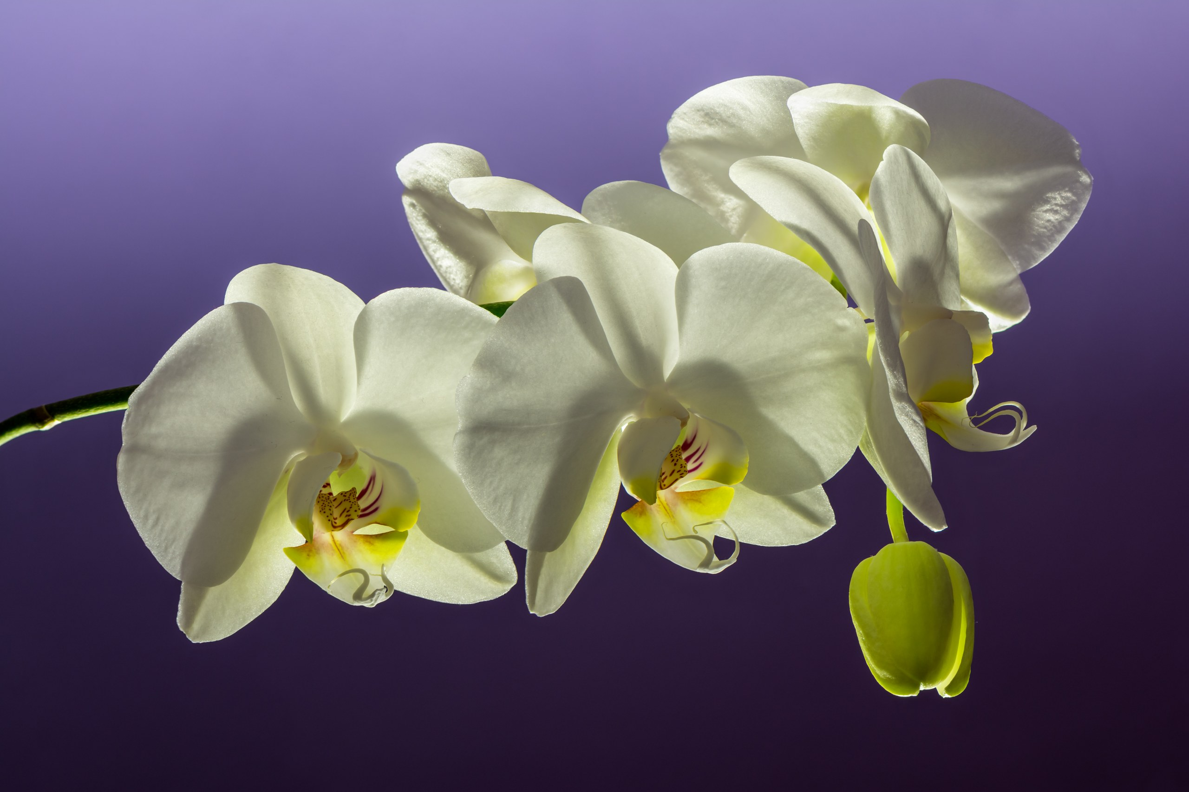
One of the entries
Phalaenopsis schilleriana, groomed and spike-supported for the table

Slide 6
Pack list
• Plant cards printed (waterproof); bloom-support stakes and soft clips.
• Distilled water mister; sterile blades plus flame.
• Microfiber and leaf shine; insurance rider copy (homeowner's, $15K orchid).
• Foam blocks and trays for the SUV.

Slide 7
The goal
• At least one award nomination for the chapter.
• Clean foliage, flat dorsals, calm load-in.

